Slide 1
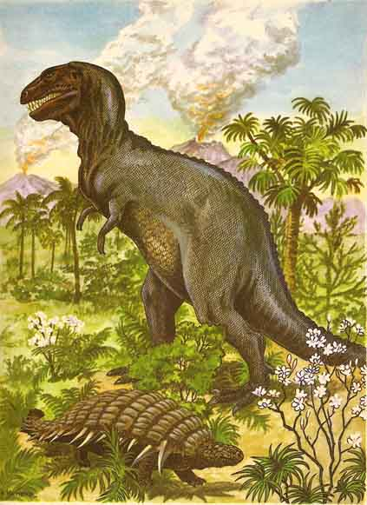
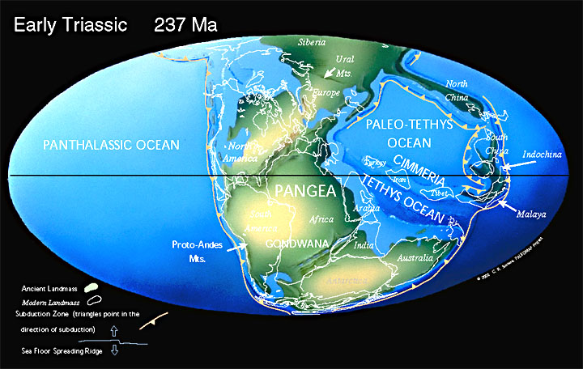
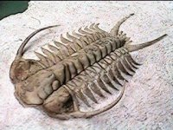
GEOL 2020 HISTORICAL GEOLOGY
Lecture: MWF 11:15-12:05
Lab: R 2-5 in Brack 423
Dr. Alan Coulson

Slide 2
Getting Started
Things to cover today
1- Roll Call
2- Syllabus Review
3- How to Succeed in this Class
4- Class Introduction
LAB TOMORROW! Bring calculator!

Slide 3

1 Call Roll

Slide 4
2- Syllabus
Posted on Blackboard in Content folder
This is your guide to the class
Many questions can be answered by READING THE SYLLABUS

Slide 5
Syllabus Basics
Office Hours
Textbook
Basic policies:
  No cheating
  No harassment/disruptive behavior
  SDS issues? Let me know asap
  15 minutes before cancelling class
  Cells turned off/muted

Slide 6
Syllabus: Grades
Normal 10-pt scale
  A = 100-90
  B = 89-80
  C = 79-70
  D = 69-60
  F = 59-0
0.50 rounds up, 0.49E rounds down
  Ex: 79.5 is a B
  Ex: 79.49999999999999999999 is a C
Q: 89.501 = ???

Slide 7
Syllabus: Grades
4 mid-term exams (14% ea)
  Your one lowest MID-TERM exam gets dropped
  If you miss an exam for any reason, that’s the one that gets dropped
1 cumulative final exam (13%)
1 Term paper (10%)
1 Class presentation (9%)
6 Lab quizzes (1% ea)
1 Lab mid-term (10%)
1 Lab final (10%)

Slide 8
Grade Penalties
Miss 1 lab = no extra penalty
  Cannot make up missed labs/quizzes
Miss > 1 lab = -10% each
  ex: miss 2 labs = -10%
Q: You have an 85 in the class but missed 3 labs. What is your final grade?

Slide 9
Grading Policies
Grading mistakes must be reported within 1 wk of the assignment being returned to the class
Make-ups require a written, Univ-approved excuse
No work will be accepted late
NO GRADES ARE CURVED
NO EXTRA CREDIT WILL BE GIVEN
These policies are ABSOLUTE and FINAL

Slide 10
Syllabus: Other Stuff
Important dates (e.g., holidays, exams) are listed
Chapters from the book related to each lecture are given

Slide 11
3: Tips for Doing Well in this Class
#1- Attendance
Not graded*, but students who skip class a lot do poorly in my courses
If you want to do well, you’ll need to be here every day
* except for lab

Slide 12
Tips
#2 Take Good Notes
My tests come from the lectures & labs
  Bad notes = bad test grades
You remember < 20% of stuff you don’t write down

Slide 13
More Tips
Don’t just rely on slides I post on Blackboard
The slides I post & show might have HALF the info I expect you to know
The rest I explain in class and expect you to take notes on

Slide 14
More Tips
#3 Tests are short answer and fill in the blank, not multiple choice
  Makes guessing the answer extremely hard.

Slide 15
More Tips
#4 Get help early if you start to struggle
Don’t wait until Easter to try and pull your grade up
I have 300+ students/semester, so you have to let me know if you’re having trouble

Slide 16
4- Class Intro: GEOL 2020
Things that make the class hard:
1- thinking in deep time
  Q: Which is longer:
80 million yrs or 0.1 billion yrs?
  Q: Which is older:
Ordovician (448 Ma) vs
Cambrian (0.542 Ga)?

Slide 17
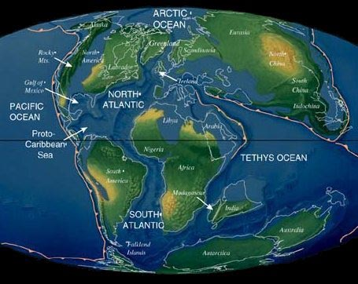
The Hard Stuff
Things that make the class hard:
2- lots of geography
3- lots of names & dates
4- Keep track of changes through time
5- Stuff you learn in Week 1 will still come up in Week 15

Slide 18
Evolution Disclaimer
This class investigates the history of life from a scientific perspective, so we’ll utilize the scientific theory of Evolution
Theories & Beliefs are different; one does not negate the other
Answers in this class must be scientific explanations
  Ex- Answering “why did the dinosaurs go extinct?” w/ “God did not allow them onto Noah’s Ark” = 0 points

Slide 19
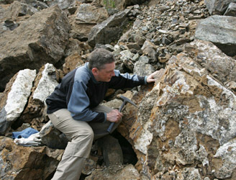
Why Study Historical Geology?
1- Formation names, the geologic timescale, etc is stuff that professional geologists will expect you to know

Slide 20
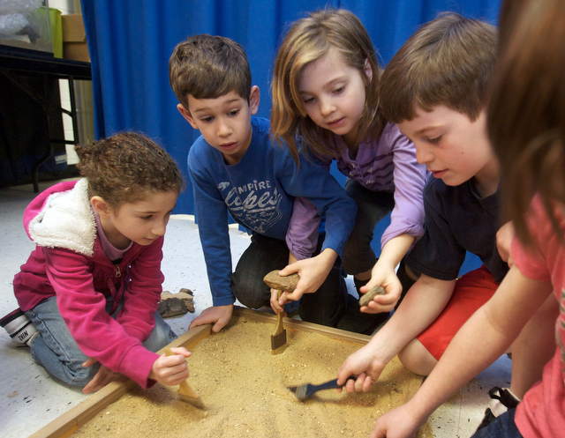
Why Study Historical Geology?
2- Fossils are very popular; people expect geologists to be able to identify them

Slide 21
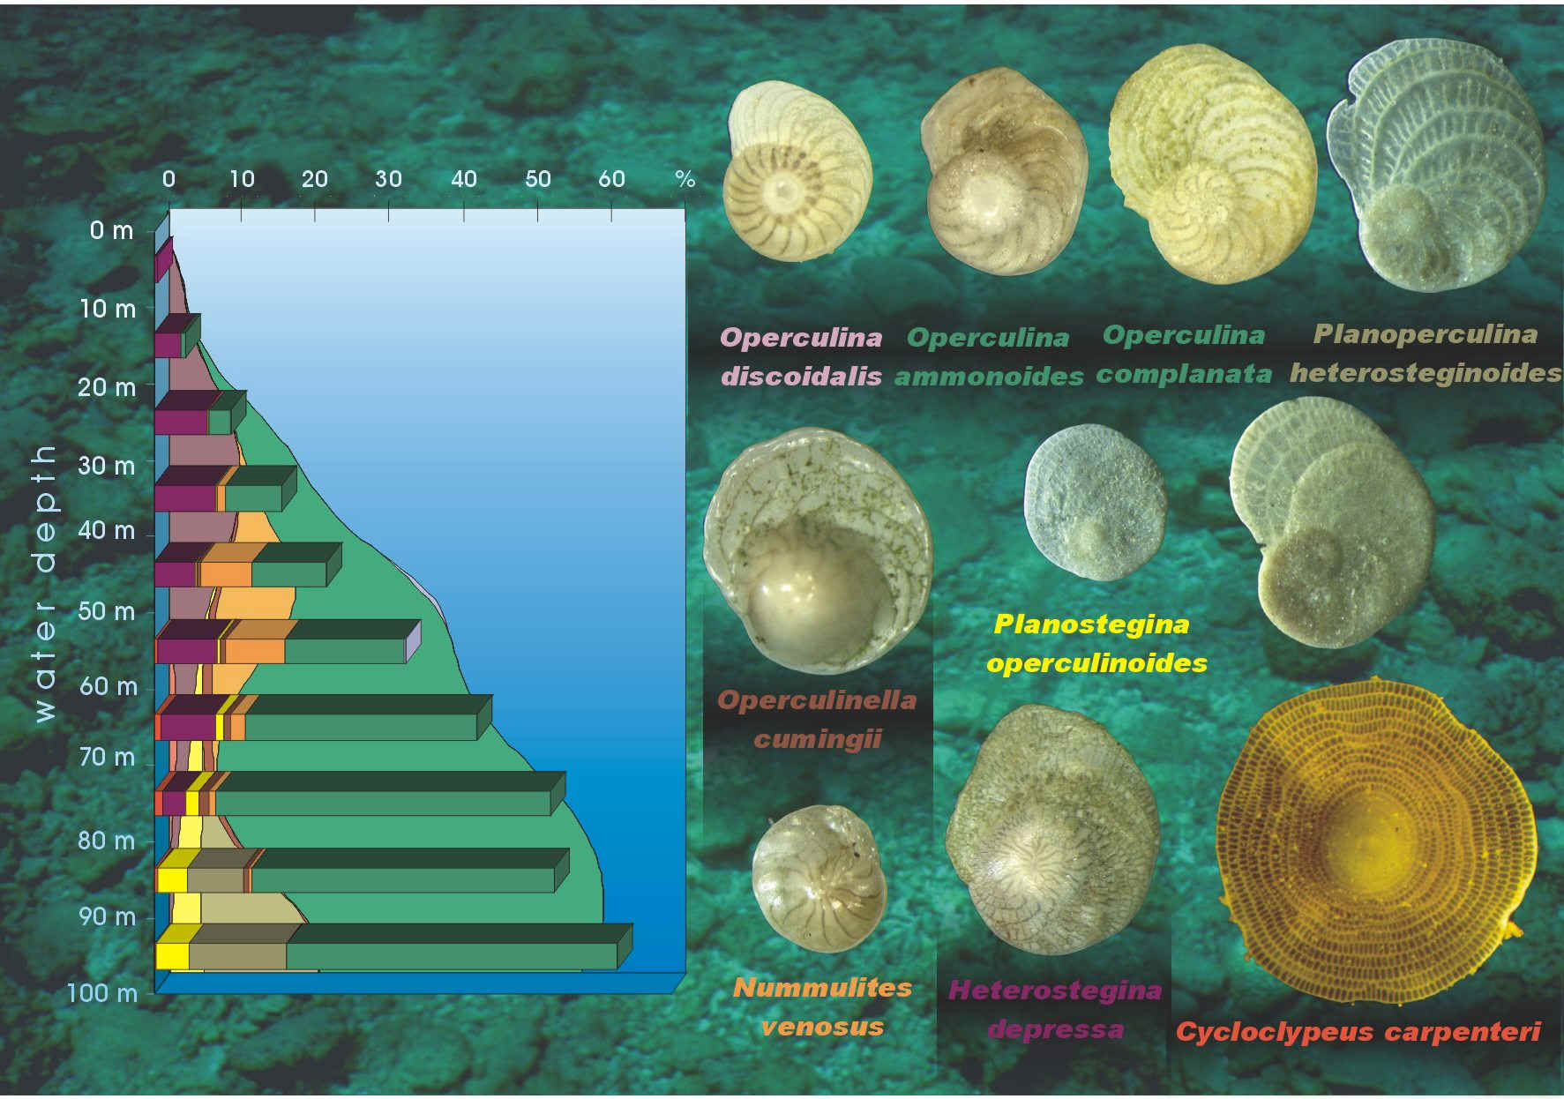
Why Study Historical Geology?
3- Paleoclimate research is a big field currently

Slide 22
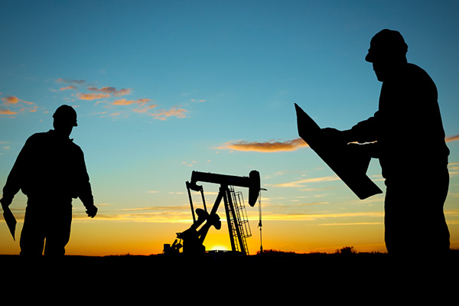
Why Study Historical Geology?
4- Fossils are still a key tool for hydrocarbon exploration

Slide 23
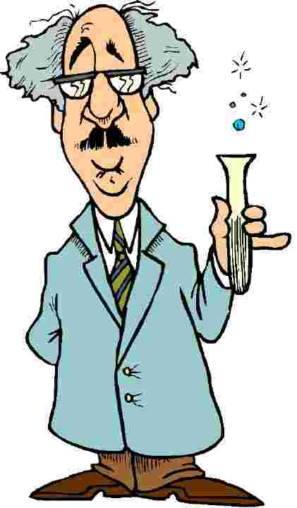
Science
Attempts to explain the world around us
Based on facts
Scientific Method

Slide 24
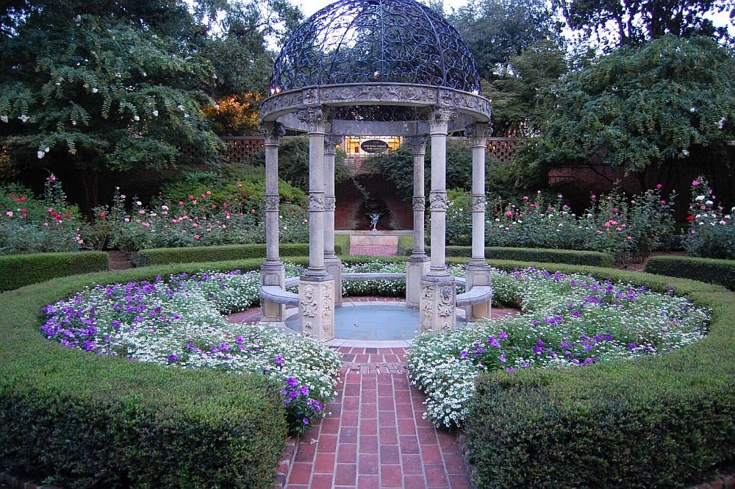
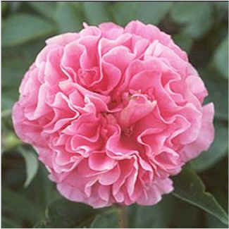
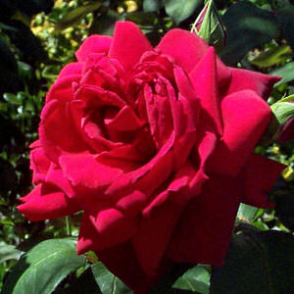
Scientific Method
0- Make an observation
1- Ask a question
2- Form a hypothesis

Slide 25
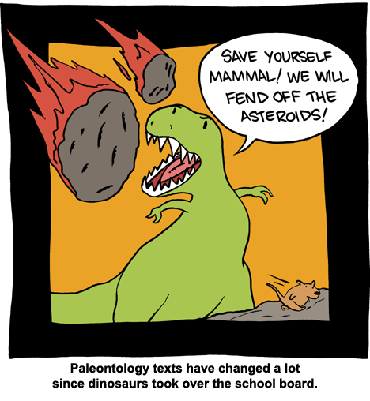
Hypotheses
A good hypothesis is testable
  Ex: if I give the plants more water, they will grow faster
You do not have to re-create an event in order to develop hypotheses that explain it
Some hypotheses are hard to test, but that’s ok

Slide 26
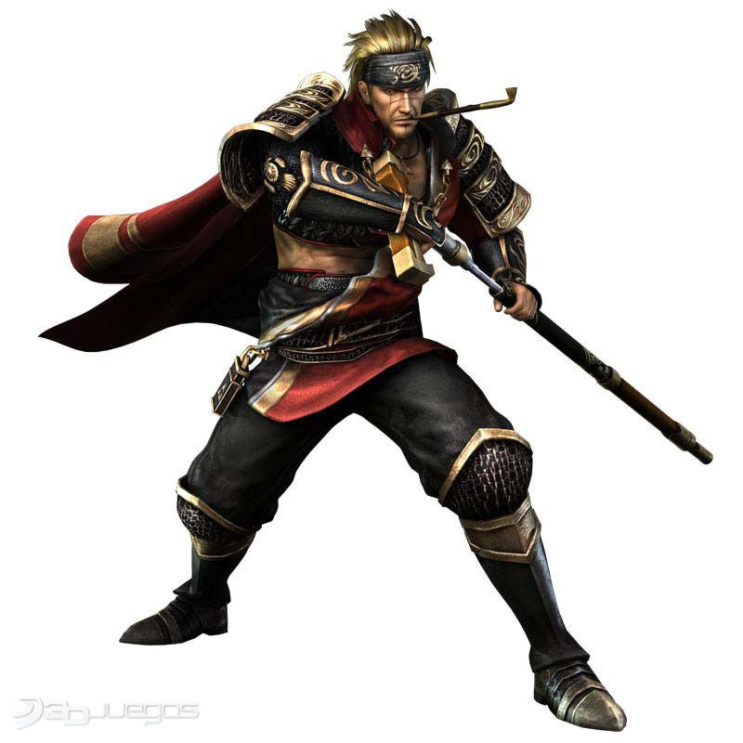
Hypotheses- Good or Bad?
When you die your spirit goes to the planet Yuggoth when you become a type of intelligent fungus
Assassins Creed 4 is better than Samurai Warriors 3
Mammoths went extinct because cavemen hunted them all down 10,000 yrs ago

Slide 27
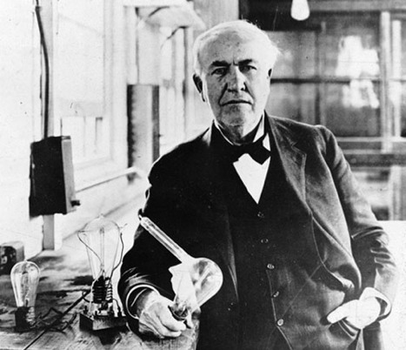
Scientific Method
3- Gather information (data)
4- Use your data to evaluate your hypothesis

Slide 28
Scientific Method
Theory-
Science vs Pop Culture
Principle-
Law-
Theories and laws are tested and revised too!
You must have scientific data to challenge scientific ideas
  Ex- can’t just say “I don’t believe in global warming”

